Slide 1
Driving complex DWH changes by ODI metadata
Jurica Vučković, Hrvoje Šušak
Rovinj – October, 2023

Slide 2
1
Speakers Introduction
2
ZABA Data Warehouse Model (DWH)
3
Change Types, Impact & ODI Lineage
4
ODI Metadata Model
5
Outcomes & Conclusion

Slide 3
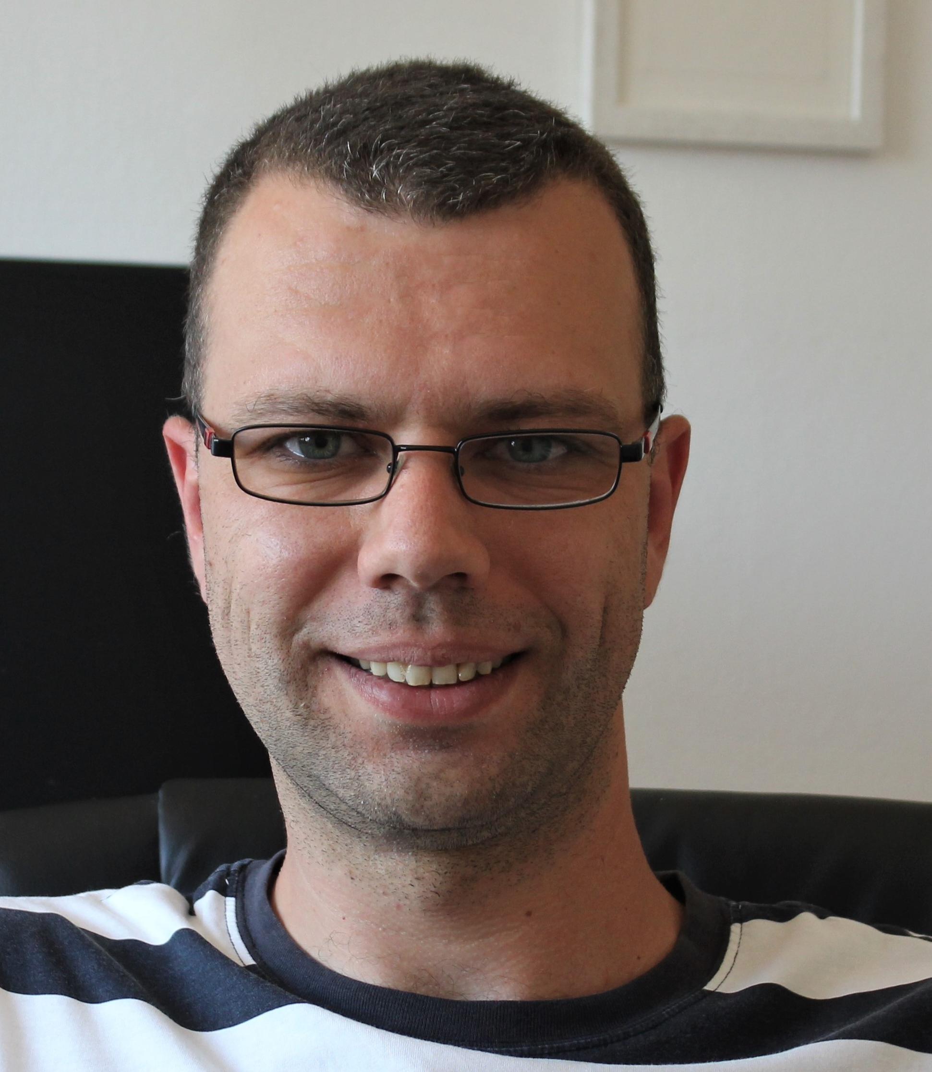
Speakers introduction
1
2
3
4
5
Experience (16 years)
Experience (11 years)
3y
BI-DWH Team Leader
Zagrebačka banka d.d.
3y
BI-RISK Team Leader
Zagrebačka banka d.d.
DWH Consultant
Deloitte d.o.o.
BI Specialist
Zagrebačka banka d.d.
2y
2y
Hrvoje Šušak
BI-DWH Team Leader
BI Software Developer
Zagrebačka banka d.d.
Jurica Vučković
BI-RISK Team Leader
Development Specialist
Splitska banka d.d.
11y
4y
ETL Developer
CROZ
2y
Interest: ETL tools, databases, data models, UX/UI, data visualization
Location: Zagreb, CRO
Interest: Databases, ETL tools and DW modelling methodologies
Location: Split, CRO

Slide 4
ZABA Data Warehouse Model
1
2
3
4
5
Data Sources
Staging Area
Data Warehouse
Data Marts
Data Consumers
CORE
Transactional databases
Daily
Replication
DW
CRM
AFC
CRDA
CNB
DSA
NRT Replication
(Golden Gate)
DSA
IDP
DSA
ODI
ODI
…
70+
ODI / GG
CNB / ECB
FINA / HANFA
GROUP
Front-End apps
Internal users
…
External data

Slide 5
ZABA Data Warehouse Model
1
2
3
4
5
Data Sources
Staging Area
Data Warehouse
Data Marts
Data Consumers
CORE
Transactional databases
Daily
Replication
DW
CRM
AFC
CRDA
CNB
DSA
NRT Replication
(Golden Gate)
DSA
IDP
DSA
ODI
ODI
…
70+
ODI / GG
CNB / ECB
FINA / HANFA
GROUP
Front-End apps
Internal users
…
External data
> 1.200 batches
> 2.900 objects
> 800 batches
> 900 objects
> 800 batches
> 1.300 objects
Business Intelligence
> 2.900
> 5.200

Slide 6
Change Types, Impact & ODI Lineage
1
2
3
4
5
CHANGE TYPE
CHANGE INITIATOR & IMPACT
CHANGE INFO
ODI LINEAGE
DRIVING DWH CHANGES
Structural
Adding new columns
Renaming existing columns
Expanding column Length
Primary key changing
ODI
METADATA
CORE
STAGE
DWH
DM
CORE
STAGE
DWH
DM
Semantic
Accounting hierarchy
Business attribute meaning
Inversed exchange rate
CORE
STAGE
DWH
DM
Data
Conversion
CORE
STAGE
DWH
DM
Change initiator
Impacted layer

Slide 7
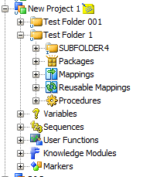
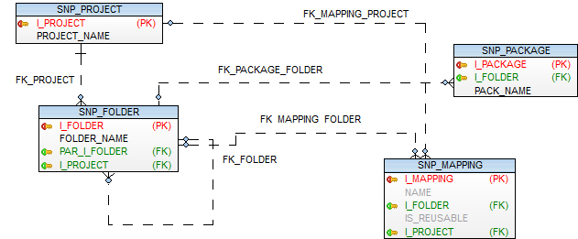
ODI Metadata Model: Project Structure
1
2
3
4
5
ODI DESIGNER OBJECTS
DATA MODEL

Slide 8
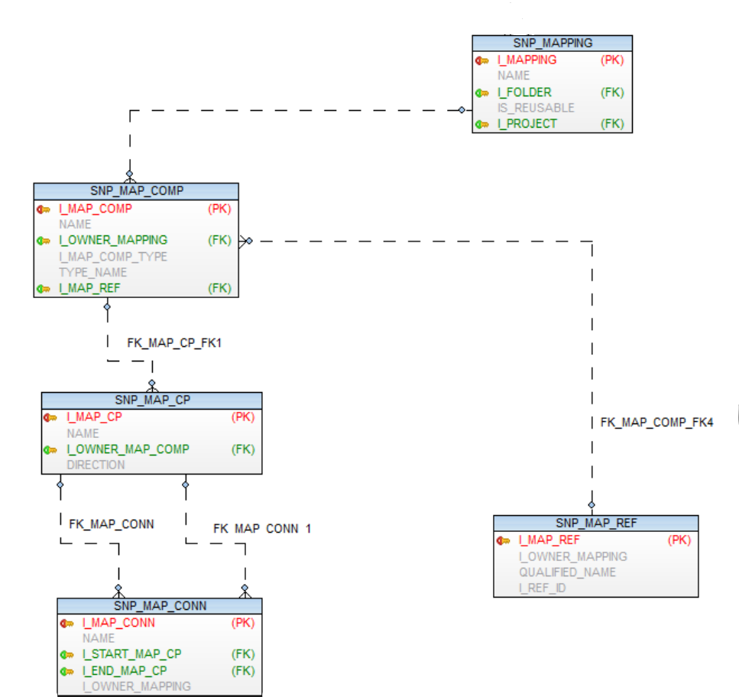
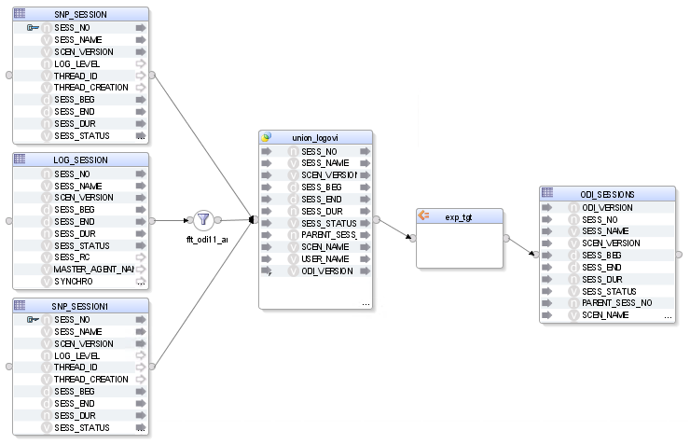
ODI Metadata Model: Mapping Structure
1
2
3
4
5
MAPPING STRUCTURE
DATA MODEL

Slide 9
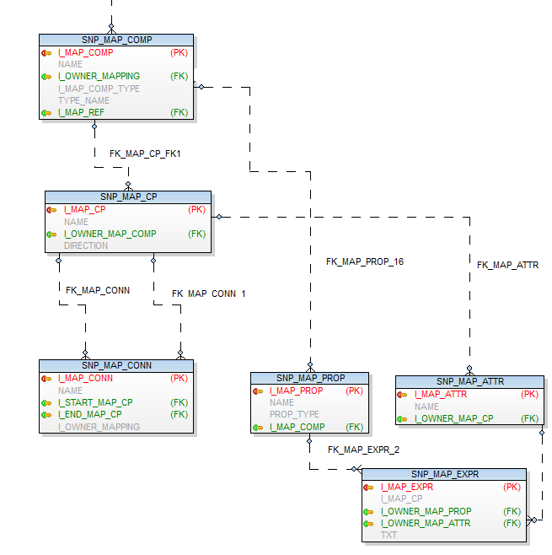
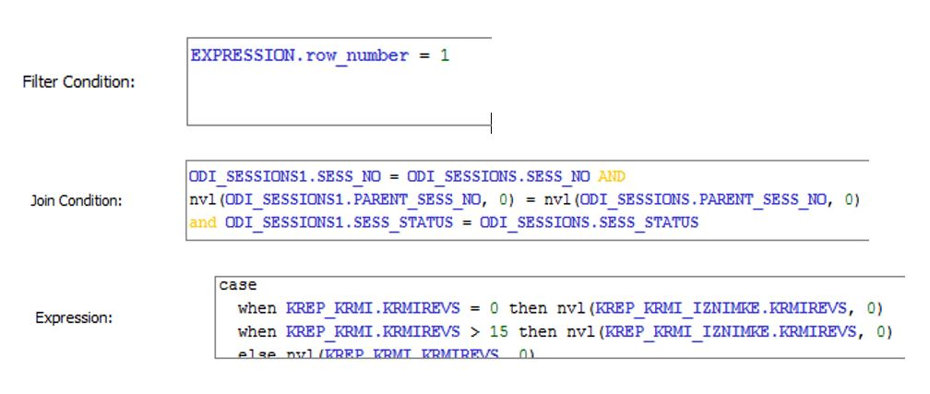
ODI Metadata Model: Column Lineage
1
2
3
4
5
STATEMENT EXAMPLES
DATA MODEL

Slide 10
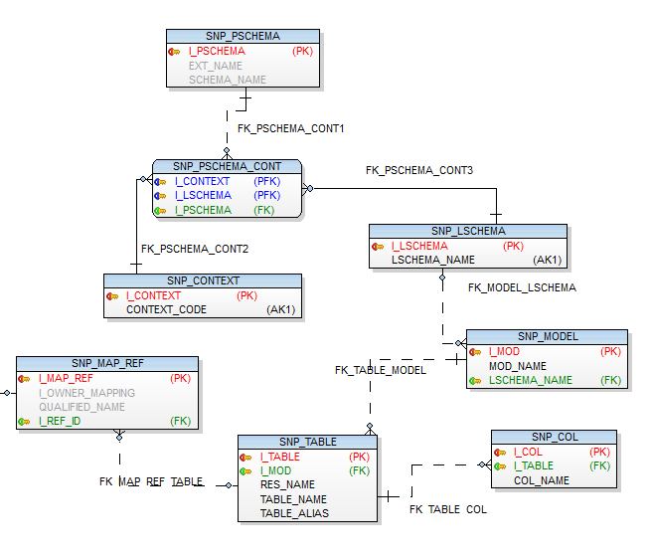
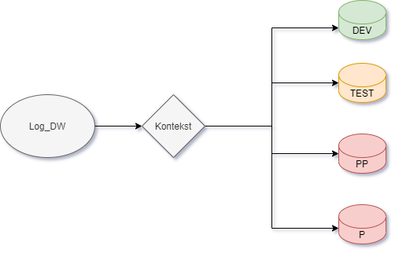
ODI Metadata Model: Topology
1
2
3
4
5
TOPOLOGY LOGIC
DATA MODEL

Slide 11
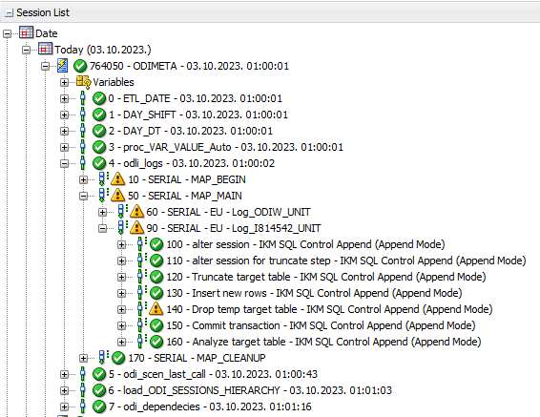
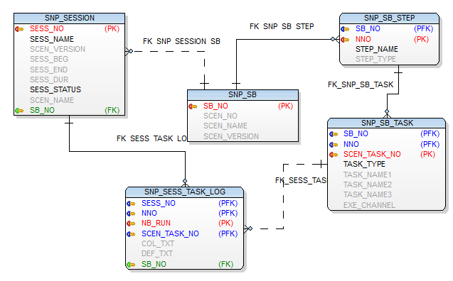
ODI Metadata Model: Session Logs
1
2
3
4
5
ODI SESSION LIST
DATA MODEL

Slide 12
Outcomes & Conclusion
1
2
3
4
5
Successful switch to EURO currency
Zagrebačka banka d.d. – 1st bank in Croatia that opened direct channels to their clients after conversion night (01.01.2023.)
Continuing usage of ODI Metadata in daily work
Fast analyses and estimations
Increased efficiency of DWH management
Decommission of unnecessary tables and batches (>600 DWH objects)

Slide 13
Contact Page
Zagrebačka banka d.d.
Jurica Vučković BI-RISK Team Leader Business Intelligence Development, IT Department Mobile +385 99 3881 955 jurica.vuckovic@unicreditgroup.zaba.hr
Zagrebačka banka d.d.
Hrvoje Šušak BI-DWH Team Leader Business Intelligence Development, IT Department Mobile +385 99 4926 894 hrvoje.susak@unicreditgroup.zaba.hr

