Slide 1
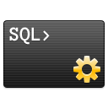
The Oracle APEX SQL Workshop Tour
Aleš Kravos, The RIGHT THING Solutions

Slide 2
Oracle APEX SQL Workshop Tour
Understand the basics of the Oracle APEX SQL Workshop
Learn more about recently added features
Discover hidden gems
How does it help the business analyst?
Make sure that everyone in the room learns something new

Slide 3
Your Guide
+15 years experience with Oracle
Passionate about APEX from 2008 (APEX 3.1)
Career change in 2019
@KravosAles
ales.kravos@right-thing.solutions

Slide 4
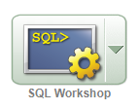
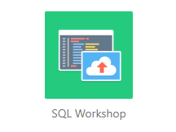
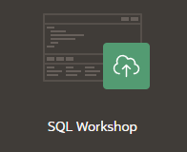
Oracle APEX SQL Workshop
APEX 3.2
APEX 5.1
APEX 23.1

Slide 5
Oracle APEX SQL Workshop
IDE (Integrated Development Environment)
Comes with APEX
Online
Integrated
APEX 3.2

Slide 6
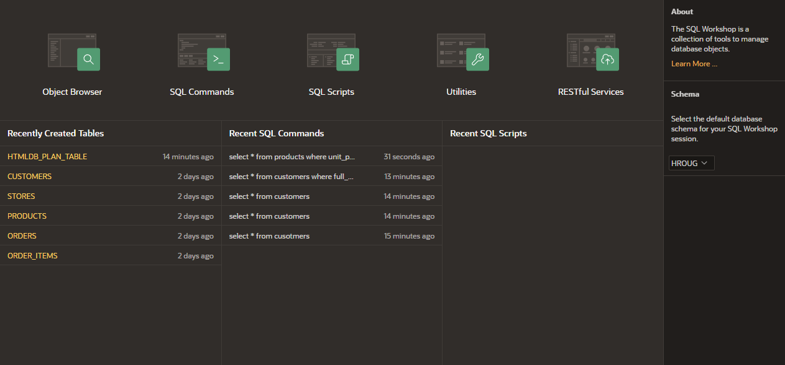
Oracle APEX SQL Workshop
APEX 23.1

Slide 7
Oracle APEX SQL Workshop

Slide 8
Oracle APEX SQL Workshop

Slide 9
Oracle APEX SQL Workshop

Slide 10
Oracle APEX SQL Workshop

Slide 11
Oracle APEX SQL Workshop

Slide 12
Oracle APEX SQL Workshop

Slide 13
Oracle APEX SQL Workshop

Slide 14
Oracle APEX SQL Workshop

Slide 15
Oracle APEX SQL Workshop
Live Demo

Slide 16
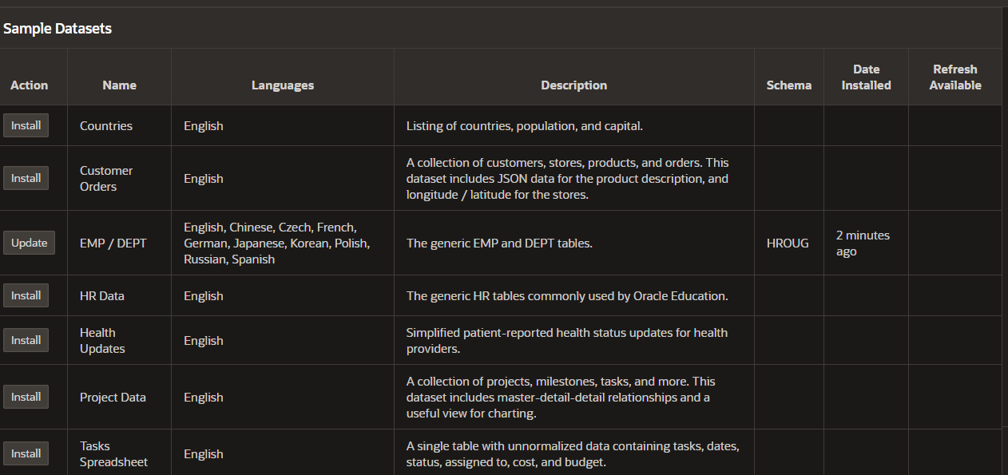
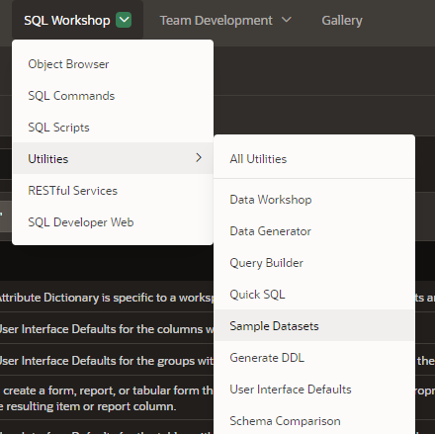
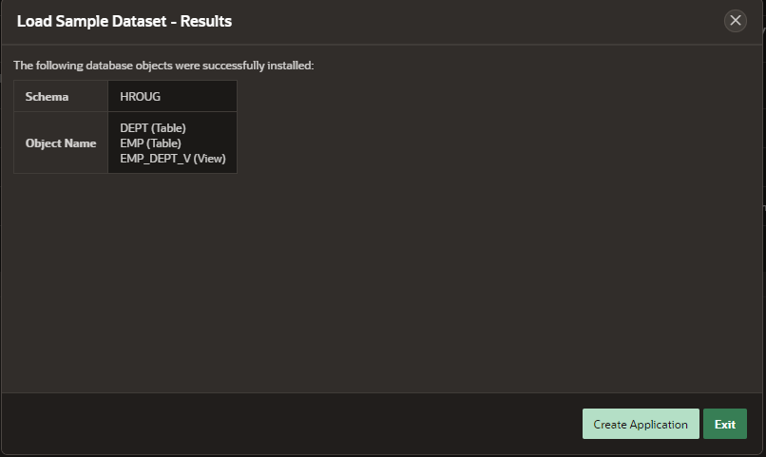
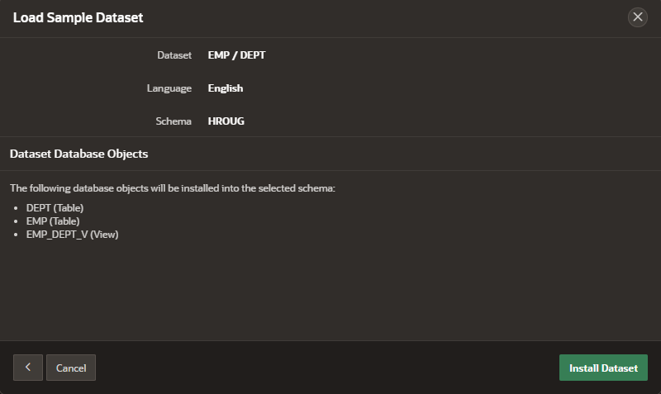
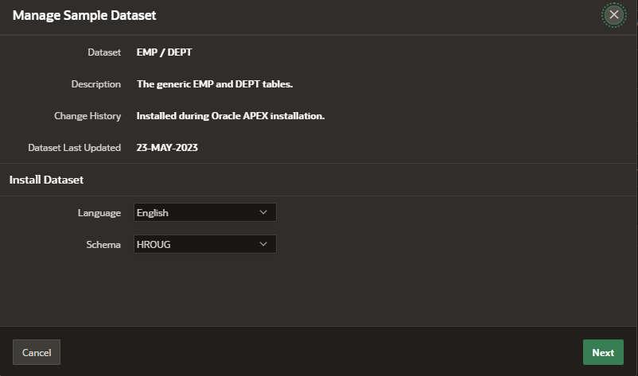
Sample Datasets

Slide 17
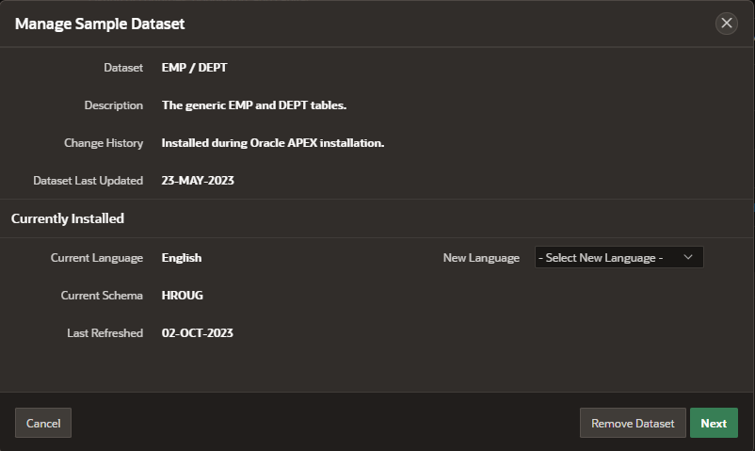
Sample Datasets

Slide 18
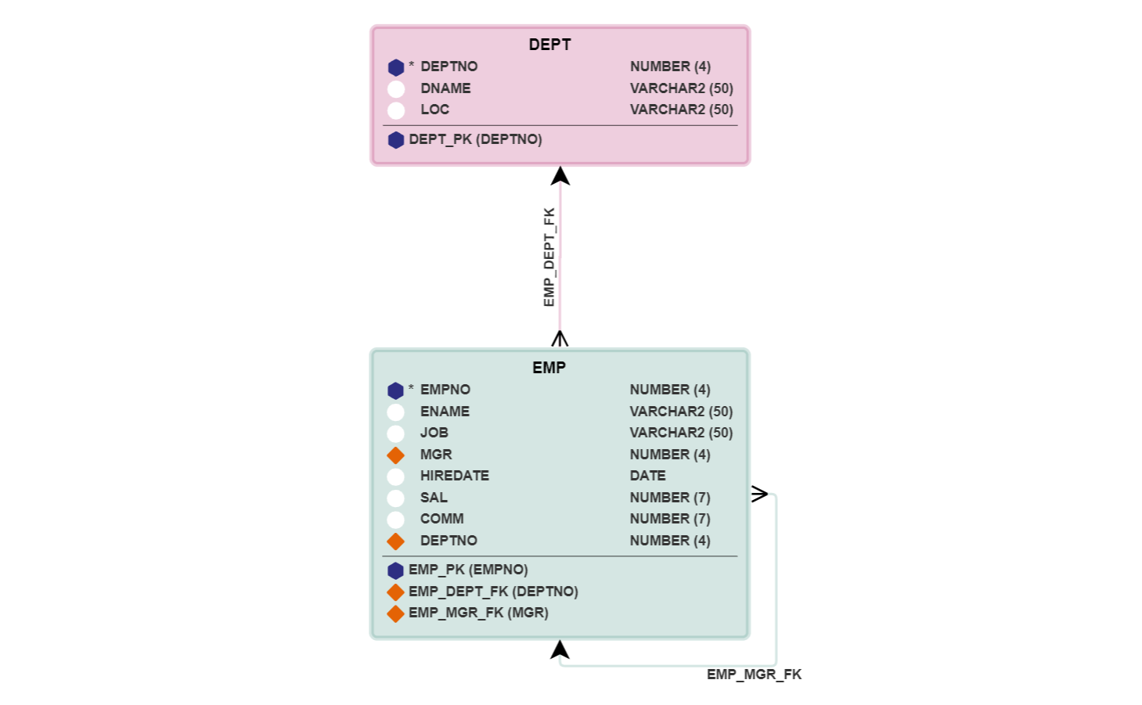
EMP / DEPT
Widely known sample data + multilingual option

Slide 19
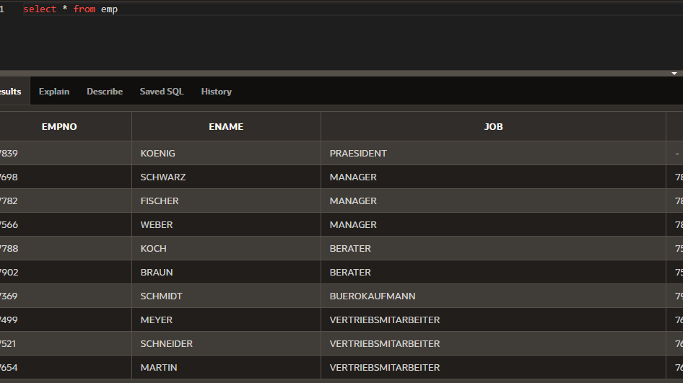
EMP / DEPT

Slide 20
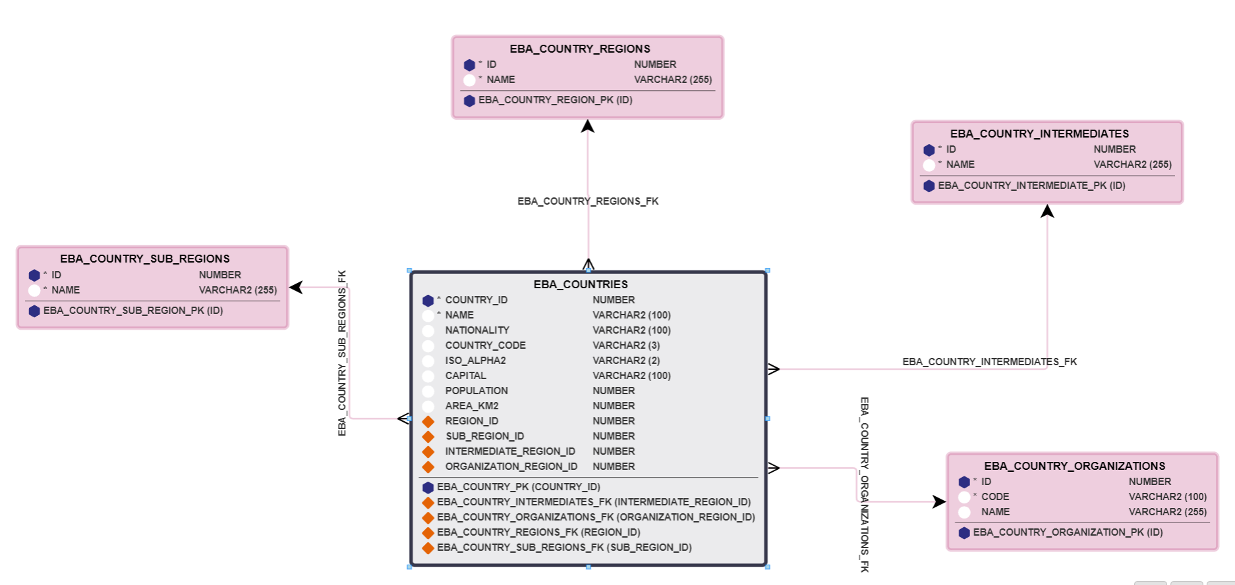
Countries
Suited for faceted search / smart filter demos

Slide 21
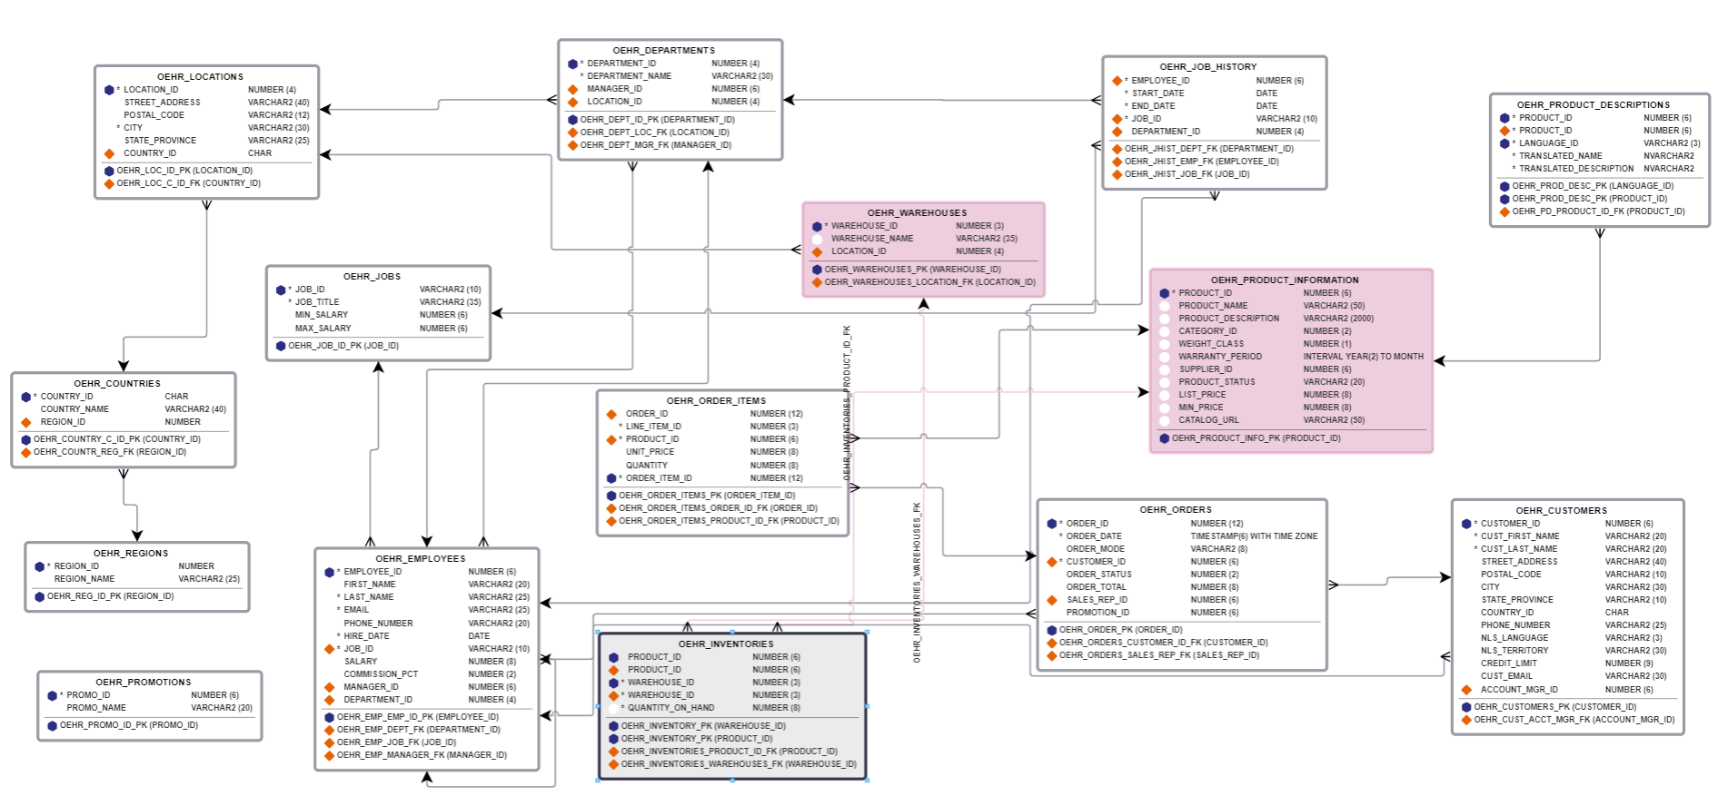
HR Data

Slide 22
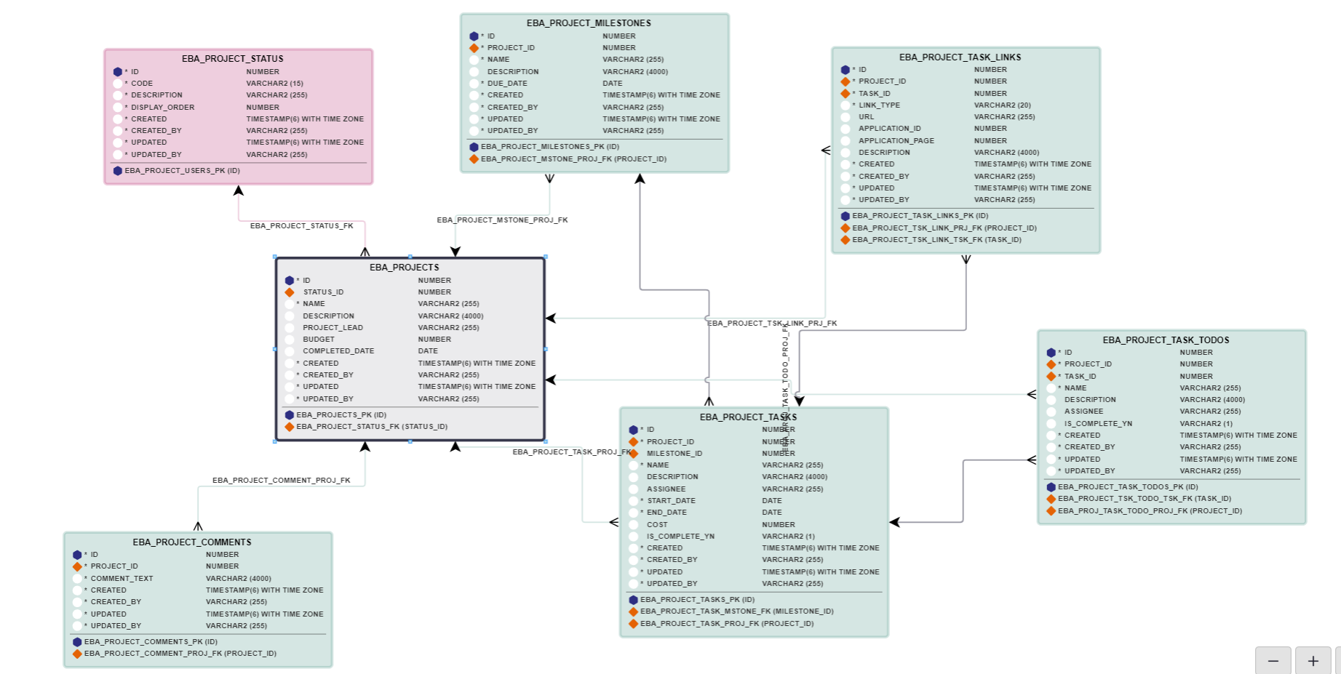
Project Data
Suitable for master -> detail -> detail demos

Slide 23
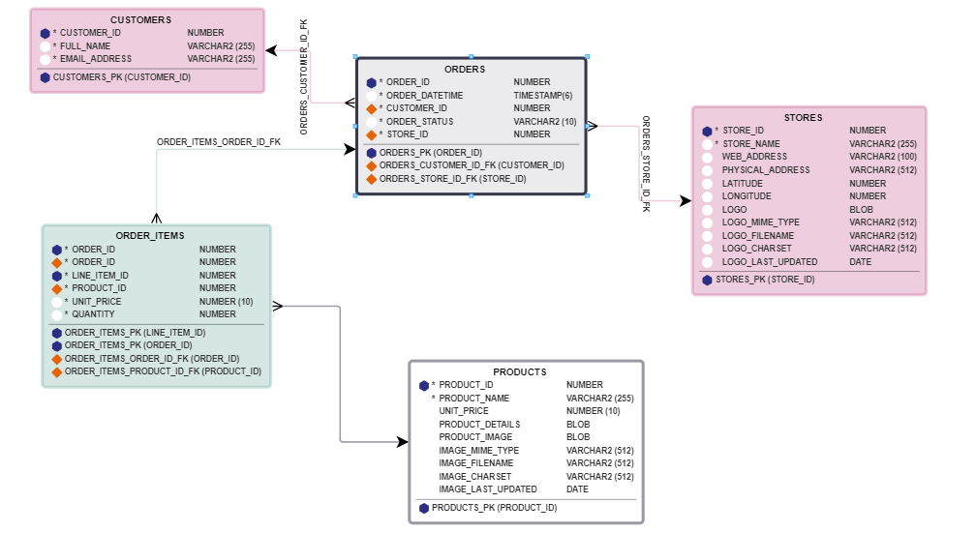
Customer Orders
This dataset includes JSON data for product description, a BLOB image and longitude / latitude for stores

Slide 24
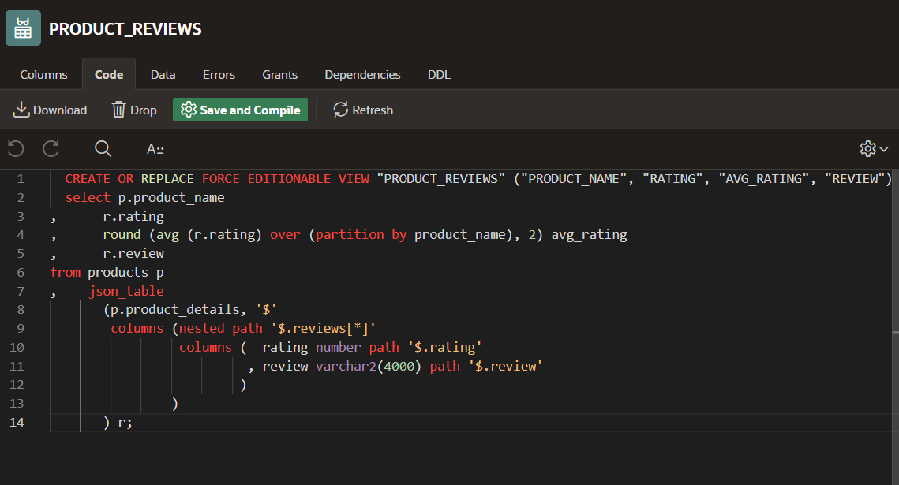
Customer Orders

Slide 25
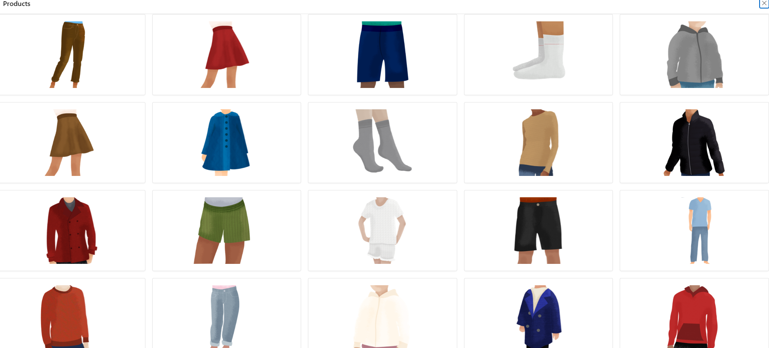
Customer Orders

Slide 26
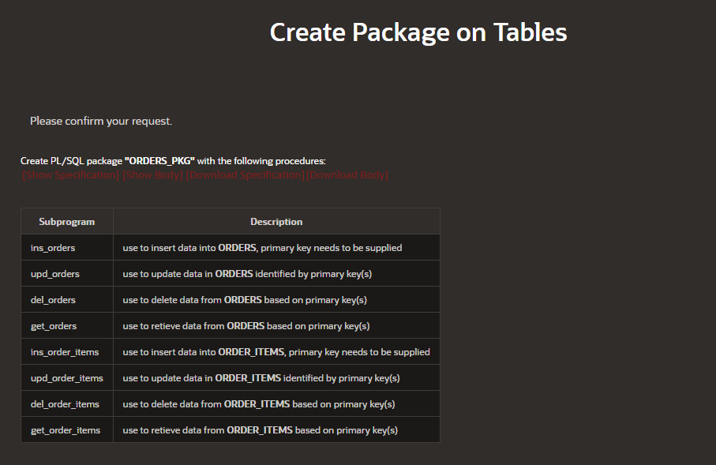
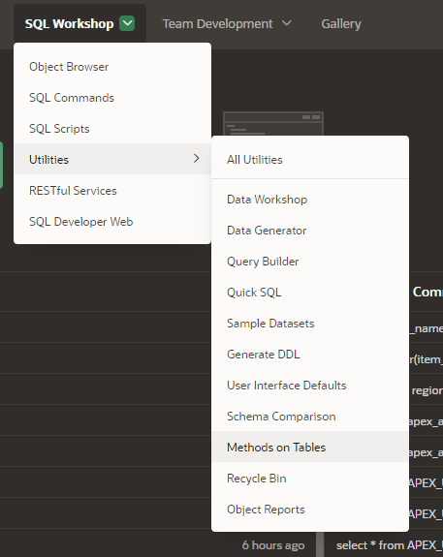
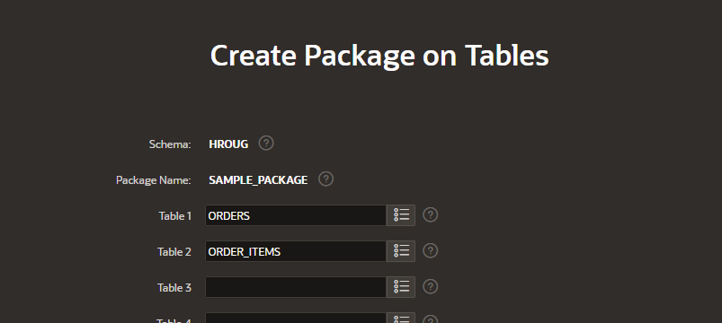
Methods on Tables

Slide 27
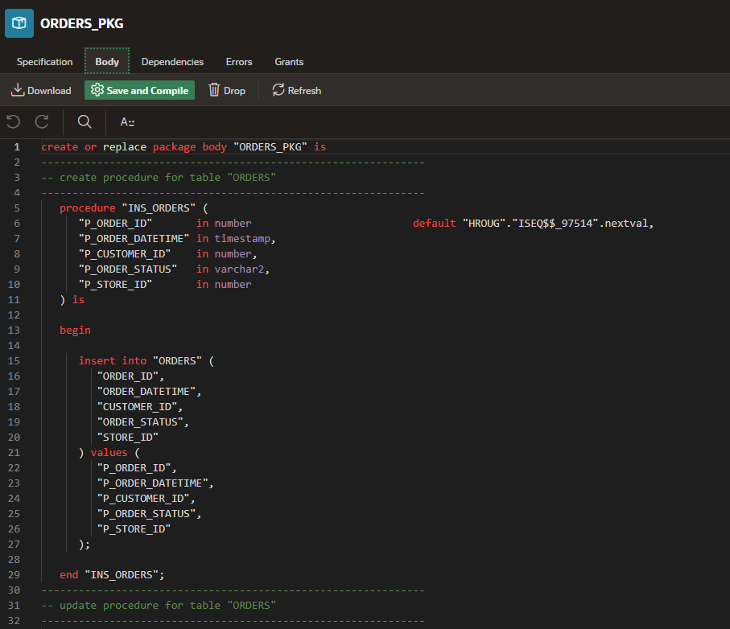
Methods on Tables

Slide 28
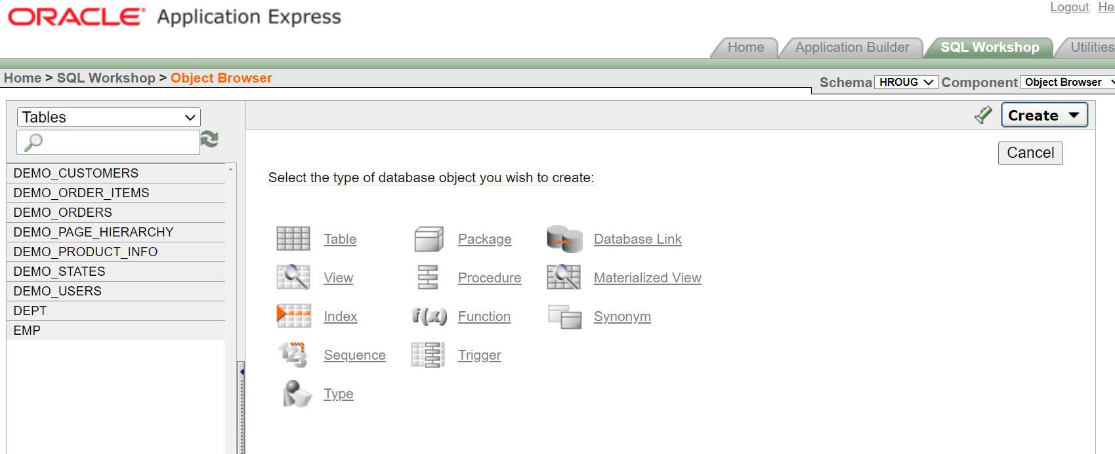
Object Browser
APEX 3.2

Slide 29
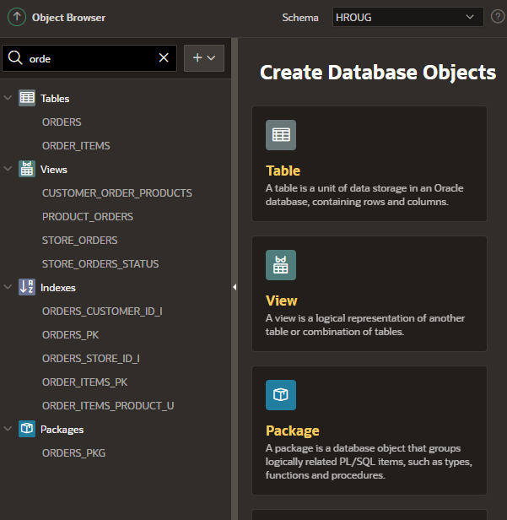
Object Browser
23.1
APEX 22.2

Slide 30
Object Browser
Live Demo

Slide 31
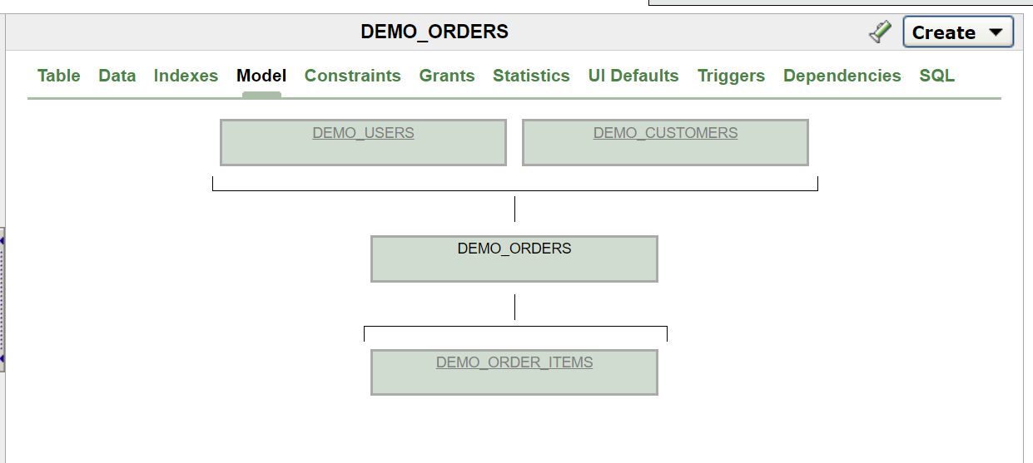
Object Browser

Slide 32
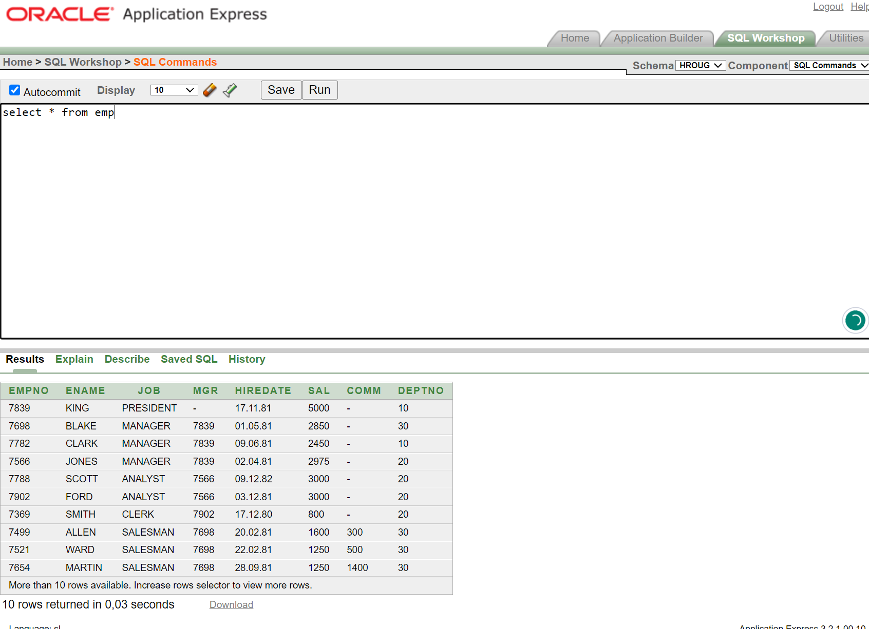
SQL Commands
APEX 3.2

Slide 33
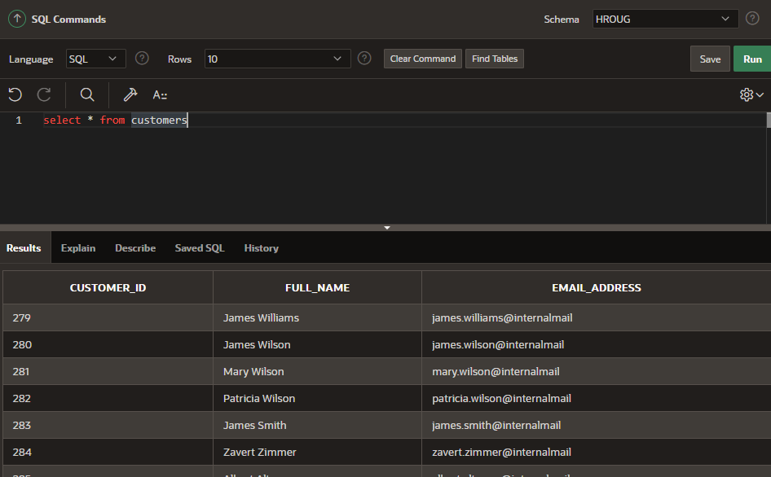
SQL Commands

Slide 34
SQL Commands
Live Demo

Slide 35
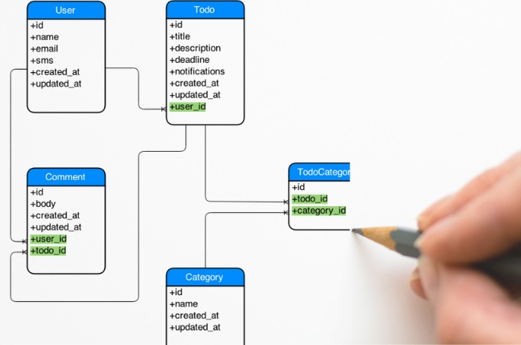

Slide 36
Quick SQL

Slide 37
Quick SQL
Since Oracle APEX 5.1 (2016)
Quickly create data models
Generate sample data
Is not a replacement for data modelling, it is simply a quick way to develop a script for simple tables and views

Slide 38
Quick SQL
Live Demo

Slide 39
Quick SQL
Table Directives
/api – Generate PL/SQL packages
/insert NN – Generate sample data

Slide 40
Quick SQL
Column Directives
/unique – Creates a unique constraint
/check – Creates a check constraint
/default – Adds a default value
/values – Value to be generated

Slide 41
Quick SQL
Column Directives
/nn – Not Null Constraint
/between – Creates a check constraint
/ref – Creates a foreign key constraint

Slide 42
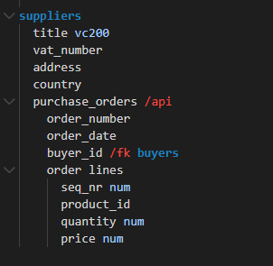
Quick SQL

Slide 43
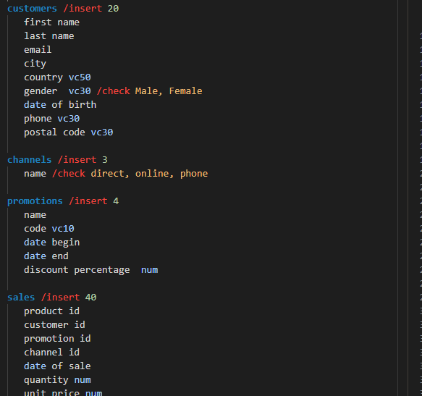
Quick SQL

Slide 44
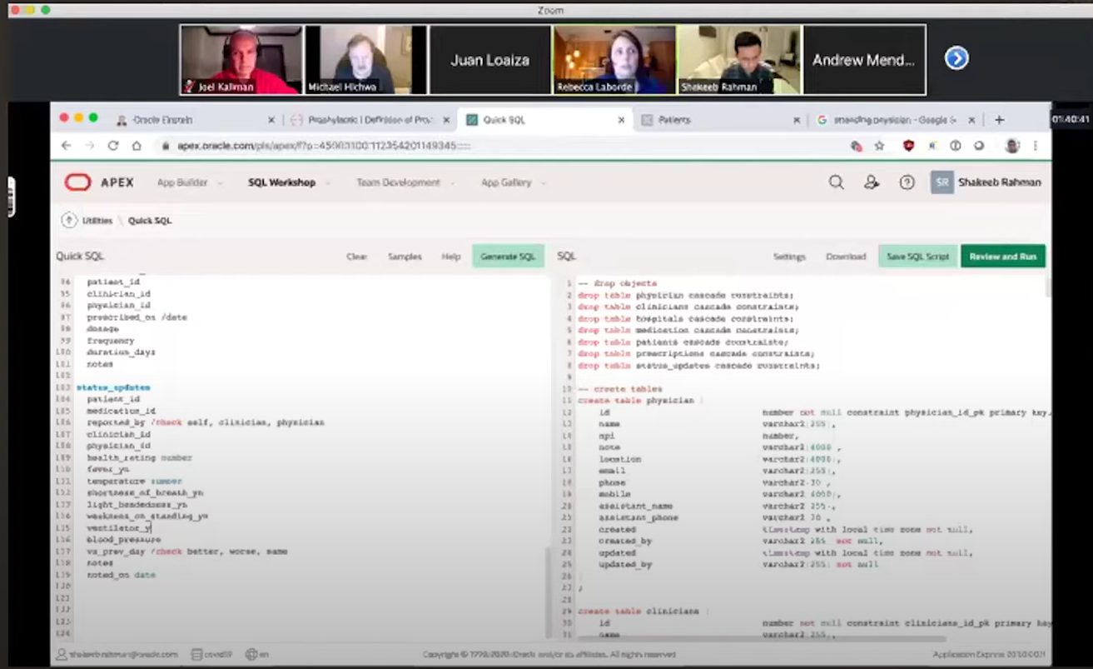
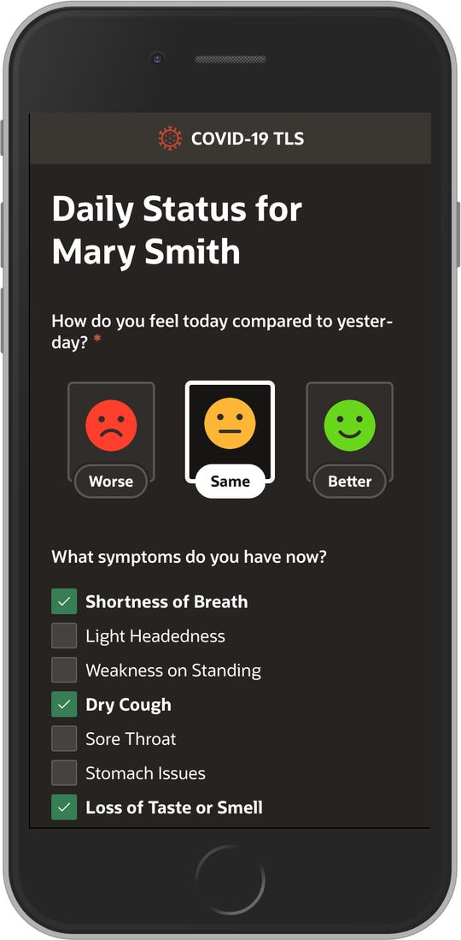
Quick SQL

Slide 45
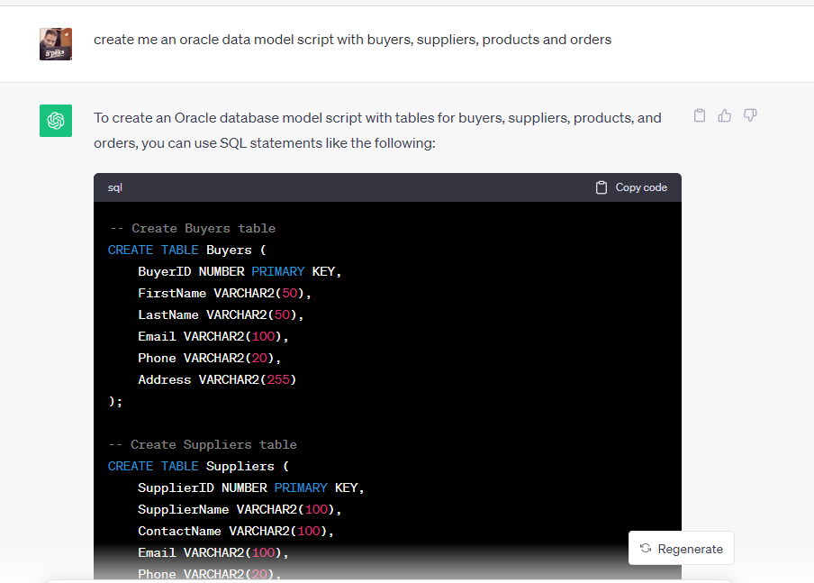
Quick SQL
Is it still useful in the AI era?

Slide 46
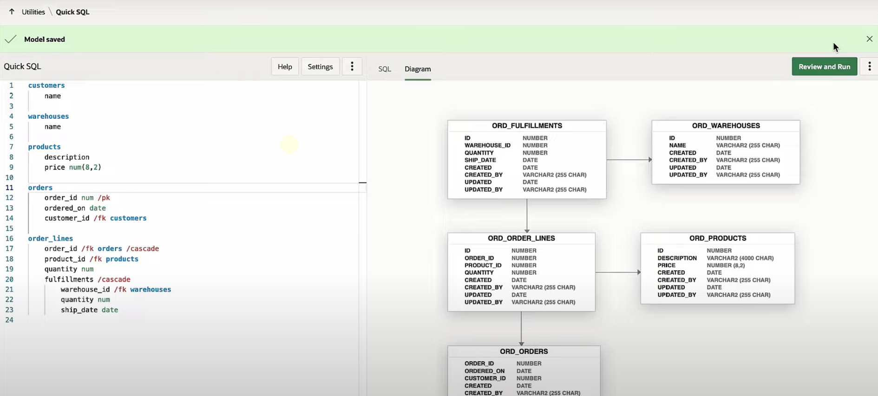
Quick SQL
APEX 23.2

Slide 47
Quick SQL

Slide 48
Data Generator

Slide 49
Data Generator
Available from Oracle APEX 22.1
Generates large volumes sample data
Highly configurable
Developers can validate their applications

Slide 50
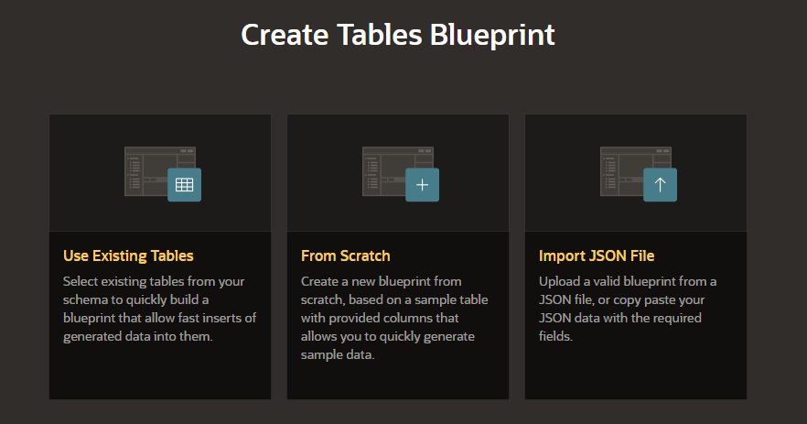
Data Generator

Slide 51
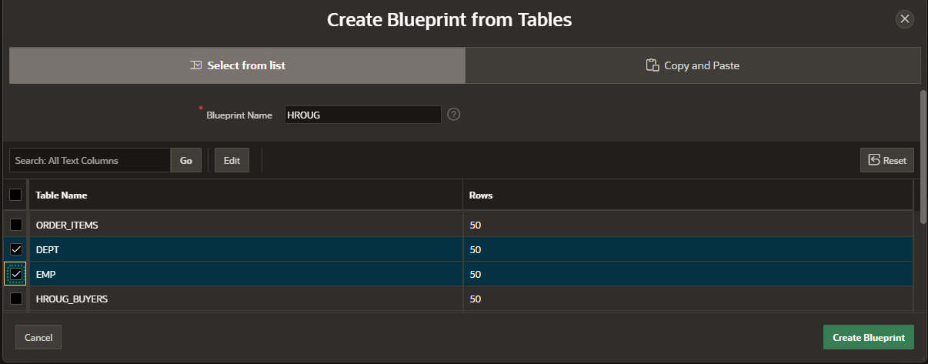
Data Generator

Slide 52
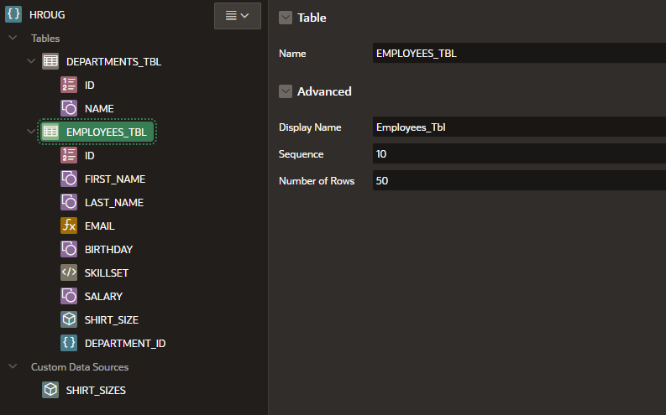
Data Generator

Slide 53
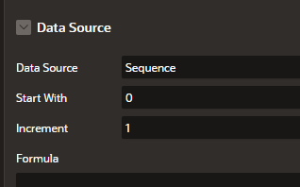
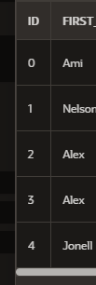
Data Source Sequence

Slide 54
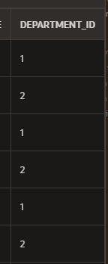
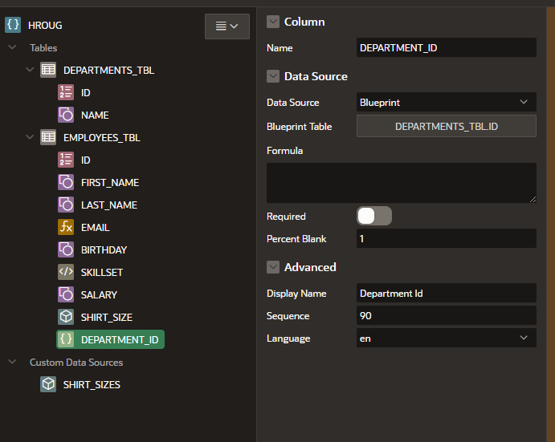
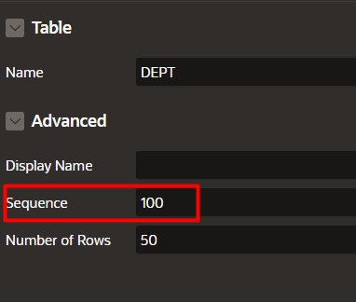
Data Source Blueprint

Slide 55
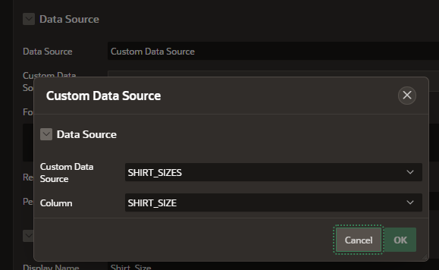
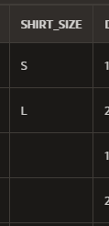
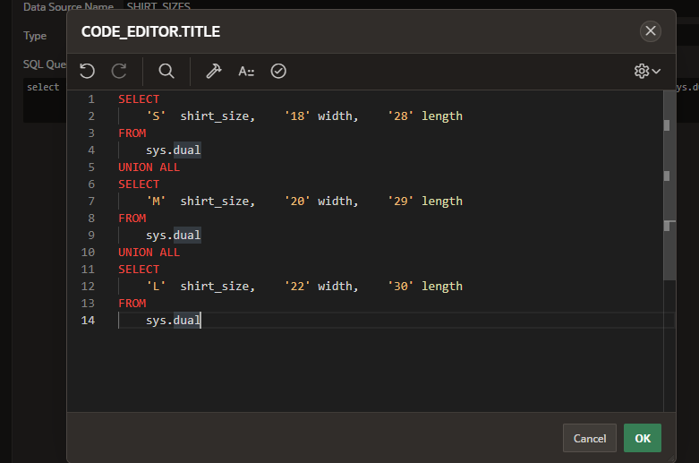
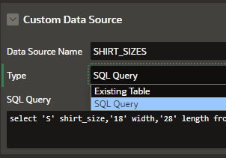
Data Source Custom Data Source

Slide 56
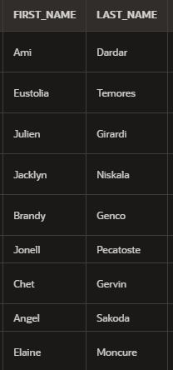
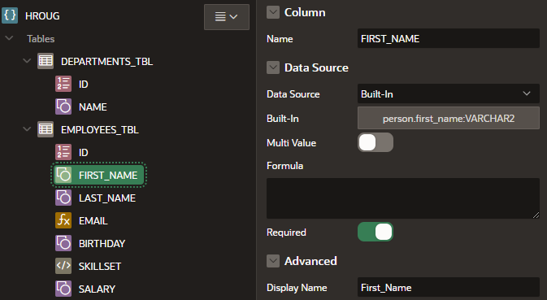
Data Source Built-Ins
https://apex.oracle.com/pls/apex/r/gamma_dev/demo/built-in-datasets

Slide 57
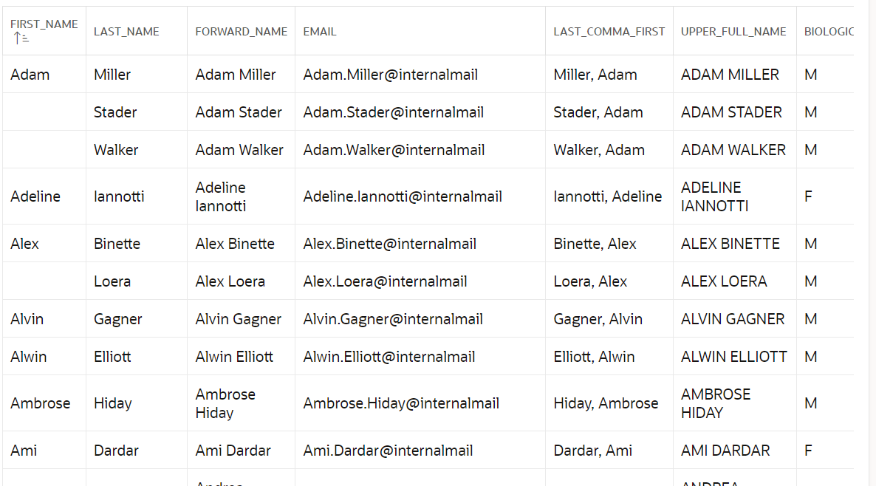
Data Source Built-Ins

Slide 58
Data Source Inline

Slide 59
Data Source Formula

Slide 60
Data Generator
File Export
JSON
CSV
SQL Insert
Insert into Database
Insert into
Fast insert into
Row Scaling

Slide 61
Data Generator
Live Demo

Slide 62
User interface Defaults

Slide 63
User Interface Defaults
User Interface Defaults enable you to assign default user interface properties for columns and page items.
Helping us to achieve consistency in our APEX Applications
Avoid doing repetitive tasks

Slide 64
User Interface Defaults

Slide 65
User Interface Defaults
Table Dictionary
Attribute Dictionary
Based on table and view columns
Based on column aliases
Extended set of properties
Limited set of properties
Takes priority on page creation
Can be used to update existing pages
Configured for database schema
Configured for workspace
Exportable
Exportable
Can be migrated to attr. dictionary
Has Synonyms

Slide 66
User Interface Defaults
Attribute Dictionary
Table Dictionary
Label
Format Mask
Display
Display Sequence
Default Value
Help Text
Item type
Type Attributes
Width
Height
Data Type
Column alignment
Required
List of Values

Slide 67
User Interface Defaults
Live Demo

Slide 68
User Interface Defaults
Works great for Forms regions
Does not work for Interactive Grid at all
Does not work at page creation for Classic Reports, Interactive Reports and Faceted Search
Does not work for region titles

Slide 69
User Interface Defaults
https://apexapps.oracle.com/pls/apex/r/apex_pm/ideas/details?idea=FR-1970

Slide 70
User Interface Defaults
https://docs.oracle.com/en/database/oracle/apex/23.1/aeapi/APEX_UI_DEFAULT_UPDATE.html#GUID-90E0D15A-4EBB-4C12-B66E-8FA76A4F31F5

Slide 71
User Interface Defaults

Slide 72
User Interface Defaults

Slide 73
Utilities

Slide 74
Tour Review
Understand the basics of the Oracle APEX SQL Workshop
Learn more about recently added features
Discover hidden gems
How does it help the business analyst / solution architect?
Make sure that everyone in the room learns something new

Slide 75
The Oracle APEX SQL Workshop Tour
ales.kravos@right-thing.solutions

